Slide 1
UML Modeling: System Sequence Diagram
Instructor: Mehroze Khan

Slide 2
Revision Up till Now
Set of Requirements
Use Case Diagram
High-Level and Expanded Use cases
Main Success Scenarios
System Sequence Diagram
Domain Model
Use case Identification
Non- Functional Requirements
Functional Requirements
Boss test
Elementary Business Process
Size Test
Represent feature/functions/user goals
Notes:
Chap 10 3rd Ed;
People do Seq Diagrams (without SSD, but would be complex as tacking larger problem and would be a large step, rather moving slowly, stepwise).

Slide 3
System Behavior
System Behavior describes what a system does, without explaining how it does it.
Before making a logical design of how the software system should work, we need to investigate and define its behavior as “Black box”.
System Sequence Diagrams (SSD)
Notes:
Chap 10 3rd Ed;
People do Seq Diagrams (without SSD, but would be complex as tacking larger problem and would be a large step, rather moving slowly, stepwise).

Slide 4
System Sequence Diagrams
System sequence diagram (SSD) are used to illustrate interaction between actor and system for a particular scenario of a use case.
A system sequence diagram is a picture that shows, main success scenario, the events that actors generate, their order and inter-system events
The purpose is to illustrate the use case in a visual format and identify all system events
SSD are drawn using UML notations
We draw SSD using Sequence Diagram notation (UML)

Slide 5
Recall – Use Cases
Use cases describe how actors interact with the software system and during this interaction
an actor generates events to a system
usually requesting some system operation to handle the event
SSD show how certain tasks are done between actors and the system (use case scenarios).
The tasks could be simple, complex or repetitive tasks.

Slide 6
Creating System Sequence Diagrams
Should be done for the typical course of events/main success scenario of the use case (and for the most interesting alternative course).
A single system sequence diagram shows the interaction between an actor and the system for one use case scenario.
It shows:
The system (as a black box)
The actor(s), especially the initiating actor
Each external system which sends messages to the system
The messages into and out of the system
The sequence in which the messages occur

Slide 7
System Events and System Operations
System operations are the operations that the system as a black box component oﬀers in its public interface.
These are high-level operations triggered by an event generated by an external actor
During system behavior analysis, system operations are assigned to a conceptual class System

Slide 8
Creating System Sequence Diagrams
Should be done for the typical course of events/main success scenario of the use case (and for the most interesting alternative course).
Draw a line representing the system as a black box.
Identify each actor and draw a line for each such actor.
From the use case typical course of events text, identify the system (external) events that each actor generates.
Illustrate them on the diagram.
Optionally, includes the use case text to the left of the diagram.

Slide 9

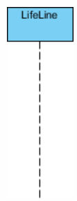
Sequence Diagram Notations
Actor:
Represent roles played by human users, external hardware, or other subjects.
Lifeline:
A lifeline represents an individual participant in the interaction.

Slide 10
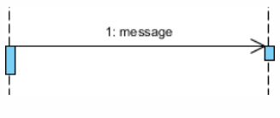
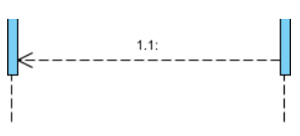
Sequence Diagram Notations
Call Message:
It defines a particular communication between the lifelines of an interaction, which represents that the target lifeline has invoked an operation.
Return Message:
It defines a particular communication between the lifelines of interaction that represent the flow of information from the receiver of the corresponding caller message.

Slide 11
Process Sale

Slide 12
Recall the Process Sale Use case
Actor Action | System Response
1. The use case begins when Customer arrives at the POST checkout with items to purchase. Cashier Starts a new Sale.
2. Cashier records each item identifier. If there is more than one item, Cashier can enter the quantity as well. | 3. Determines the Line item price and adds the Line item information to the running sales transaction. The description and price of the the current item are presented.
4. Cashier repeats 3 – 4 for all items. On completion of item entry, the Cashier indicates to the POST that item entry is complete and sale has ended. | 5. Calculates and presents the sale total with taxes.
6. The Cashier tells the Customer the total and asks for payment.
7. Customer makes payment by cash | 8. System logs completed sale 9. Provides receipt

Slide 13
How to construct an SSD from a use case?
Draw System as black box on right side
For each actor that directly operates on the System, draw a stick figure and a lifeline.
For each System events that each actor generates in use case, draw a message.

Slide 14
System Events
System event is an external input event generated by an actor (may include parameters).

Slide 15


System Sequence Diagrams
Naming: wording should be consistent with the domain
:System
: Cashier
better name
enterItem(itemID, quantity)
scan(itemID, quantity)
worse name
enterItem is what is done;
scan serves the purpose of entering an item
and is system related (bad)

Slide 16
Naming System events & operations
System events and associated system operations should be expressed at the level of intent
Use verbs from use case or make, start, enter, end etc.. rather than physical input medium or UI widget
Notes:
Vereb phrase similar to process name (of DFD).

Slide 17
Recall the Process Sale Use case
Actor Action | System Response
1. The use case begins when Customer arrives at the POST checkout with items to purchase. Cashier Starts a new Sale.
2. Cashier records each item identifier. If there is more than one item, Cashier can enter the quantity as well. | 3. Determines the Line item price and adds the Line item information to the running sales transaction. The description and price of the the current item are presented.
4. Cashier repeats 3 – 4 for all items. On completion of item entry, the Cashier indicates to the POST that item entry is complete and sale has ended. | 5. Calculates and presents the sale total with taxes.
6. The Cashier tells the Customer the total and asks for payment.
7. Customer makes payment by cash | 8. System logs completed sale 9. Provides receipt

Slide 18
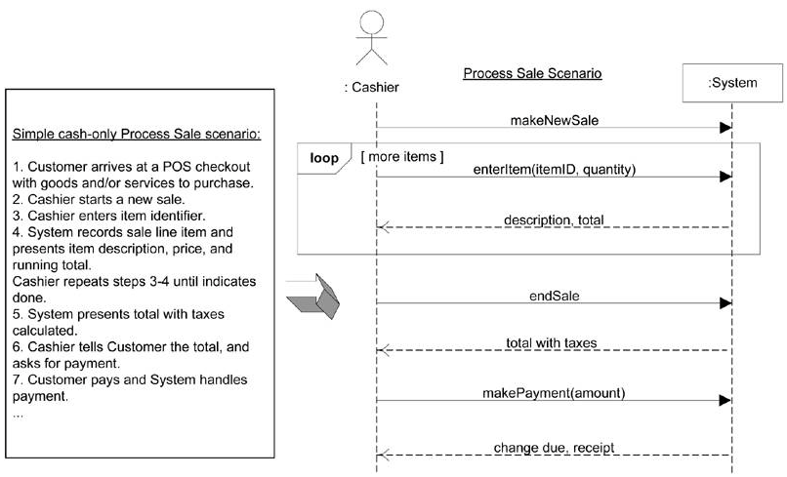

Slide 19
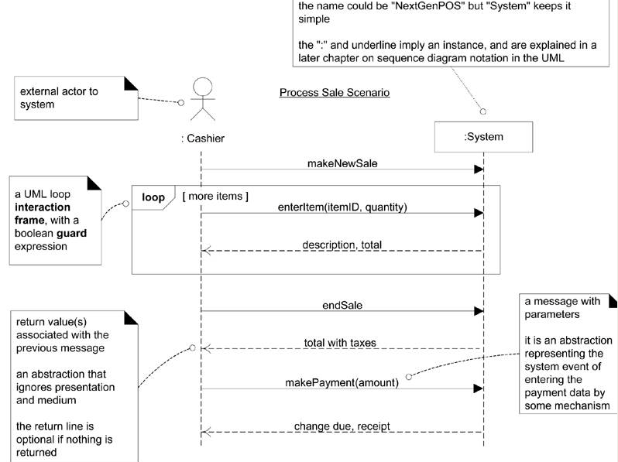

Slide 20
System Sequence Diagram Notation
.
Note that software participants cannot perform operations on human actors!

Slide 21
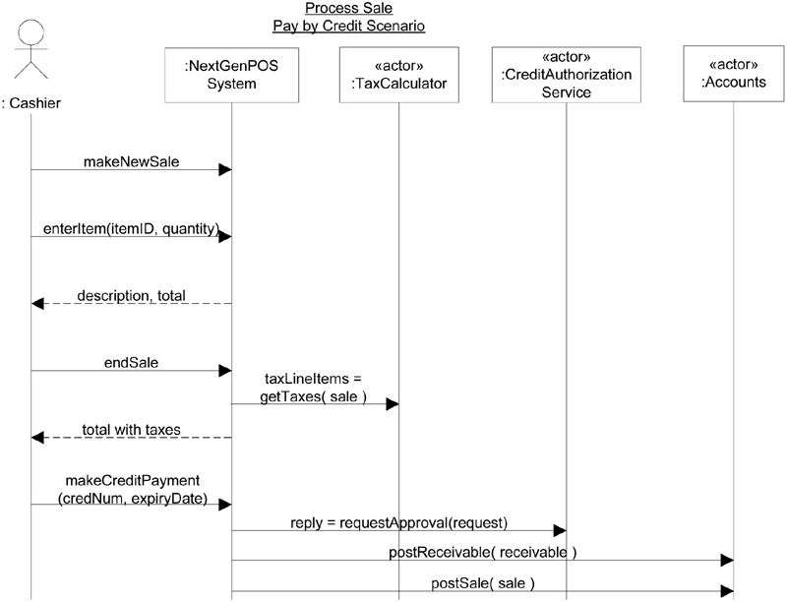
Cashier
System
makeNewSale()
These input system events invoke system operations
enterItem(itemID, quantity)
Description, total
The system event makeNewSale invoke a system operation called makeNewSale and so on
[More items]
endSale()
Total with taxes
makePayment(amount)
Similar to OOP when we say the message to invoke the method (handling operation)
Change due, receipt
System operations handle input system events.

Slide 22
Sequence Diagrams
Messages are indicated by a solid line with an arrow.
Arrow | Meaning | Arrowhead style UML 2.0
Synchronous | Transfer control and wait for answer. (sequential operations)
Return | Returns a value to the caller (optional)

Slide 23
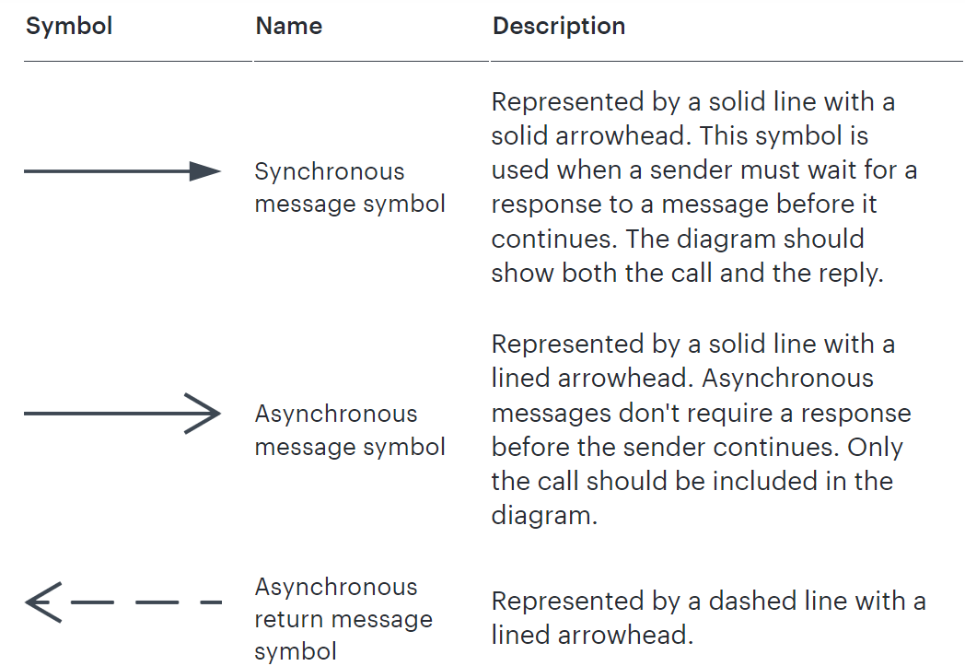
Blocking
Non-Blocking

Slide 24
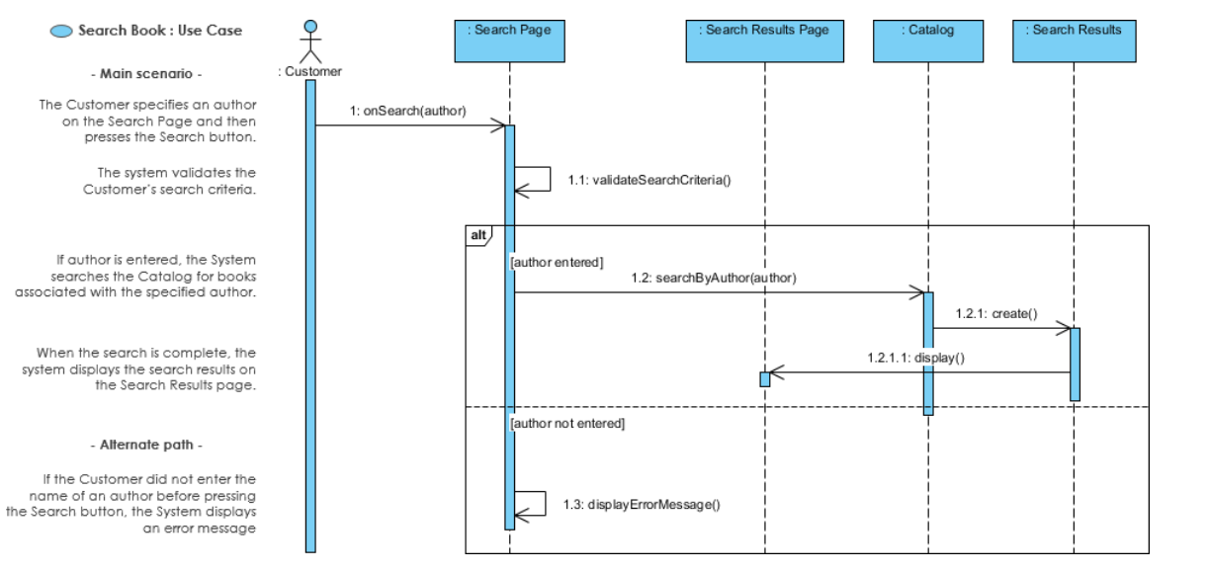

Slide 25
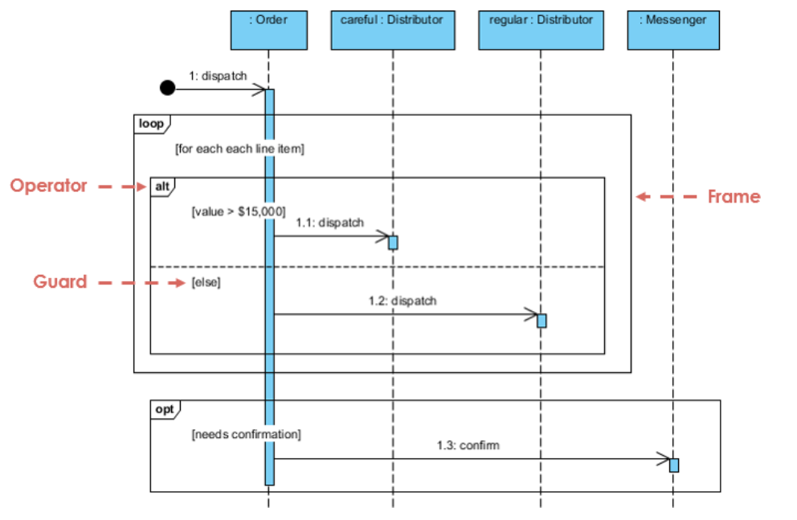

Slide 26
Sequence diagram for an emotion-based music player
Firstly, the application is opened by the user.
The device then gets access to the web cam.
The webcam captures the image of the user.
The device uses algorithms to detect the face and predict the mood.
It then requests database for dictionary of possible moods.
The mood is retrieved from the database.
The mood is displayed to the user.
The music is requested from the database.
The playlist is generated and finally shown to the user.

Slide 27
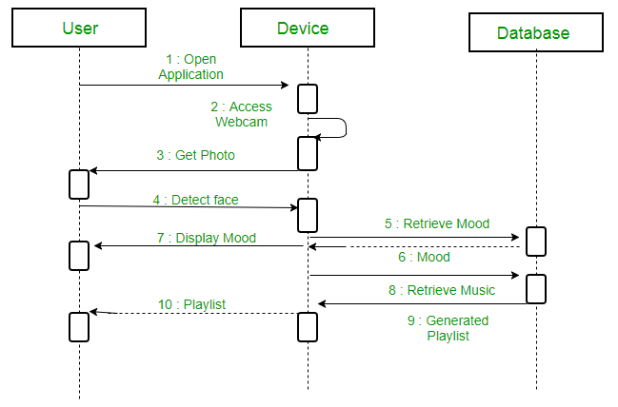
Sequence diagram for an emotion-based music player
Firstly, the application is opened by the user.
The device then gets access to the web cam.
The webcam captures the image of the user.
The device uses algorithms to detect the face and predict the mood.
It then requests database for dictionary of possible moods.
The mood is retrieved from the database.
The mood is displayed to the user.
The music is requested from the database.
The playlist is generated and finally shown to the user.

Slide 28
Class Activity

Slide 29
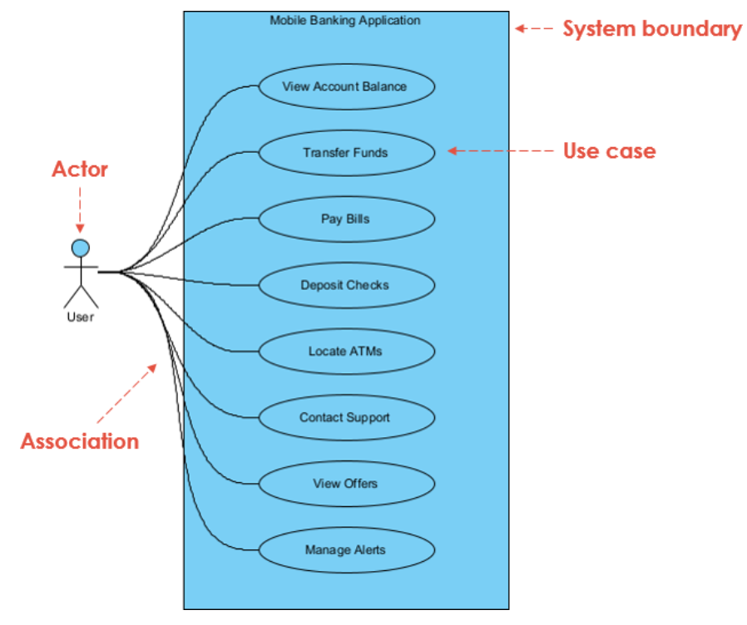

Slide 30
Use case description for the “Transfer Funds”
Use Case Name: Transfer Funds
Actors: User
Summary: This use case allows the user to transfer funds between their own accounts or to other accounts.
Preconditions: The user must be logged in to the mobile banking application.
The user must have at least one account set up in the application.
Basic Flow of Events:
The user selects the “Transfer Funds” option from the main menu.
The application presents the user with a list of their accounts and prompts them to select the account they want to transfer funds from.
The user selects the account they want to transfer funds from.
The application presents the user with a form to fill out with the recipient’s account information, including the account number and the name of the recipient.
The user fills out the form and enters the amount they want to transfer.
The application validates the recipient’s account information and the available balance in the user’s account.
If the validation is successful, the application deducts the transfer amount from the user’s account and adds it to the recipient’s account.
The application displays a confirmation message to the user with the details of the transfer.

Slide 31
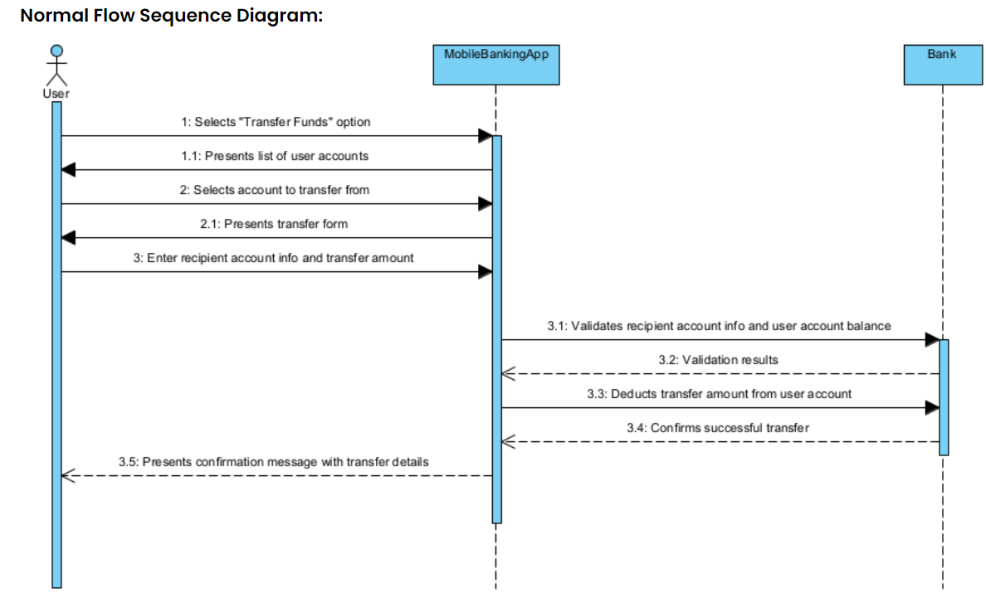

Slide 32
References
Larman, Craig. Applying UML and patterns: an introduction to object oriented analysis and design and interative development. Pearson Education India, 2012.
Object-Oriented Analysis and Design with Applications, Grady Booch et al., 3rd Edition, Pearson, 2007.
Timothy C. Lethbridge, Robert Laganaiere, Object-Oriented Software Engineering (2nd Edition), McGraw Hill, 2005
Object-Oriented Modeling and Design with UML, Michael R. Blaha and James R. Rumbaugh, 2nd Edition, Pearson, 2005.

